Slide 1
Watercolor Cards Unit
Art with Ms. Gay
Project Guidelines:
You will be creating a watercolor card. This can be a “thank you” card for a teacher (or anyone else), a late Mother’s Day card, or a Father’s Day card.
You may practice as much as you would like. I will provide watercolor paper and card stock for mounting the watercolor paintings on.
You will need to show me two practice paintings before receiving your final paper.
You may want to review the techniques we learned in the fall (wet-on-wet, salt, crayon resist, etc.)
Final cards are due by Thursday, May 19th. You will not turn these in—you will only show them to me and then take them home/give them away. I will enter the grade once I see your finished card.
You may have your final card graded before the due date for this project if you would like to have extra time to work on your Genius Hour project.

Slide 2
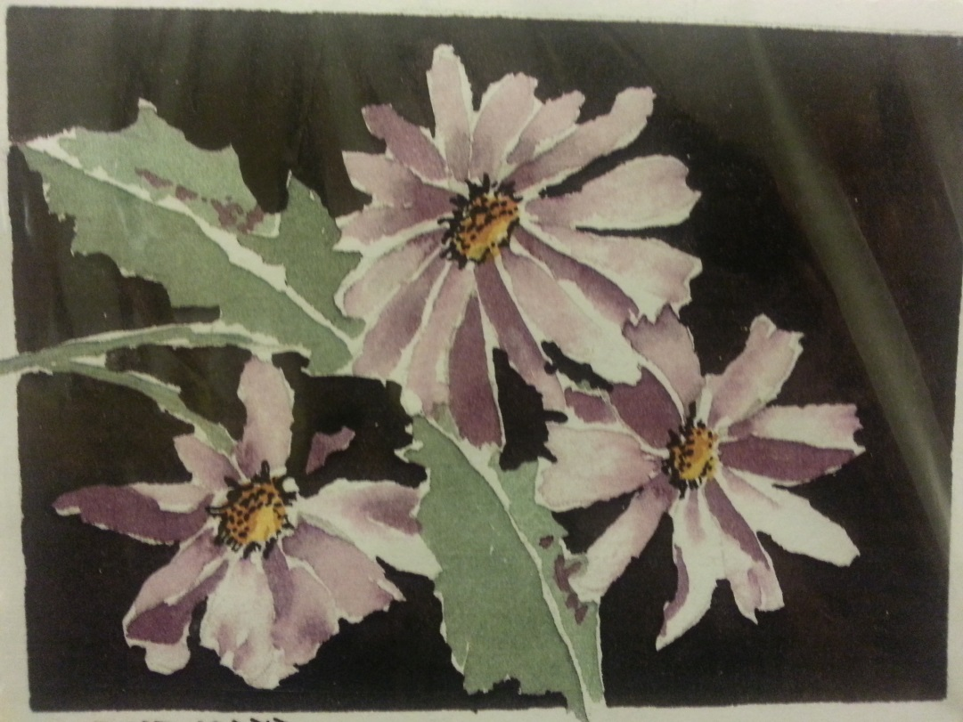
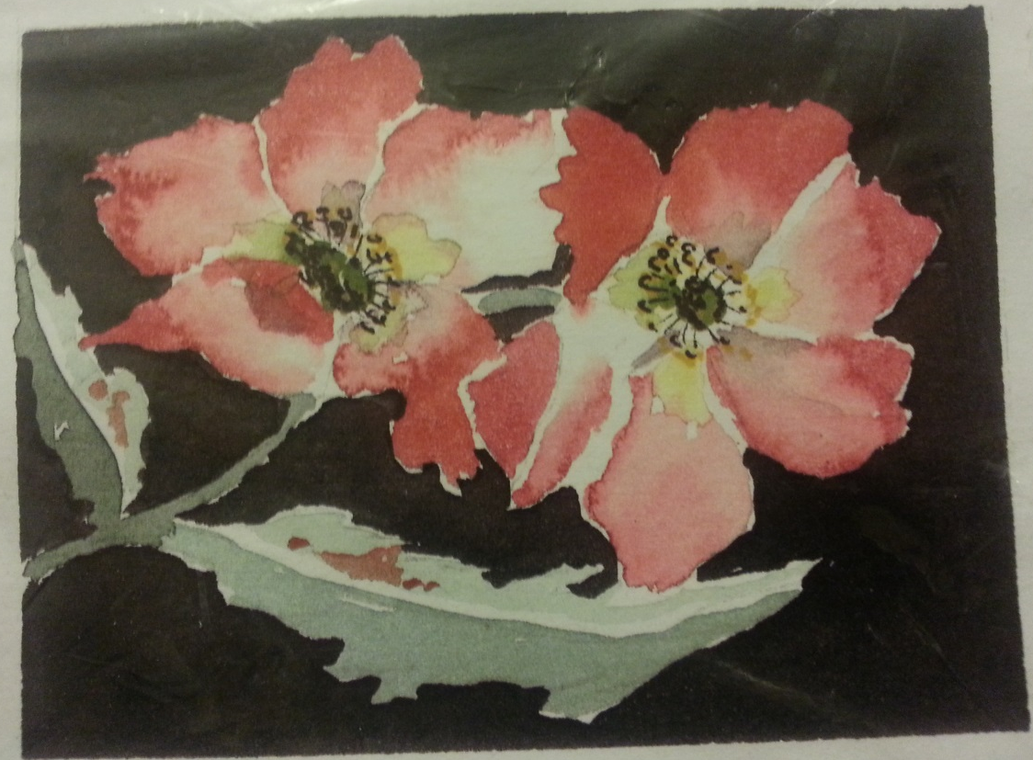

Slide 3
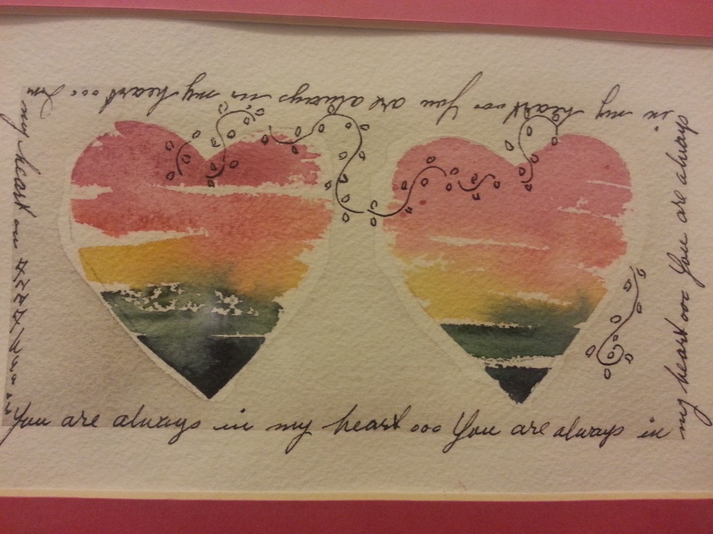

Slide 4
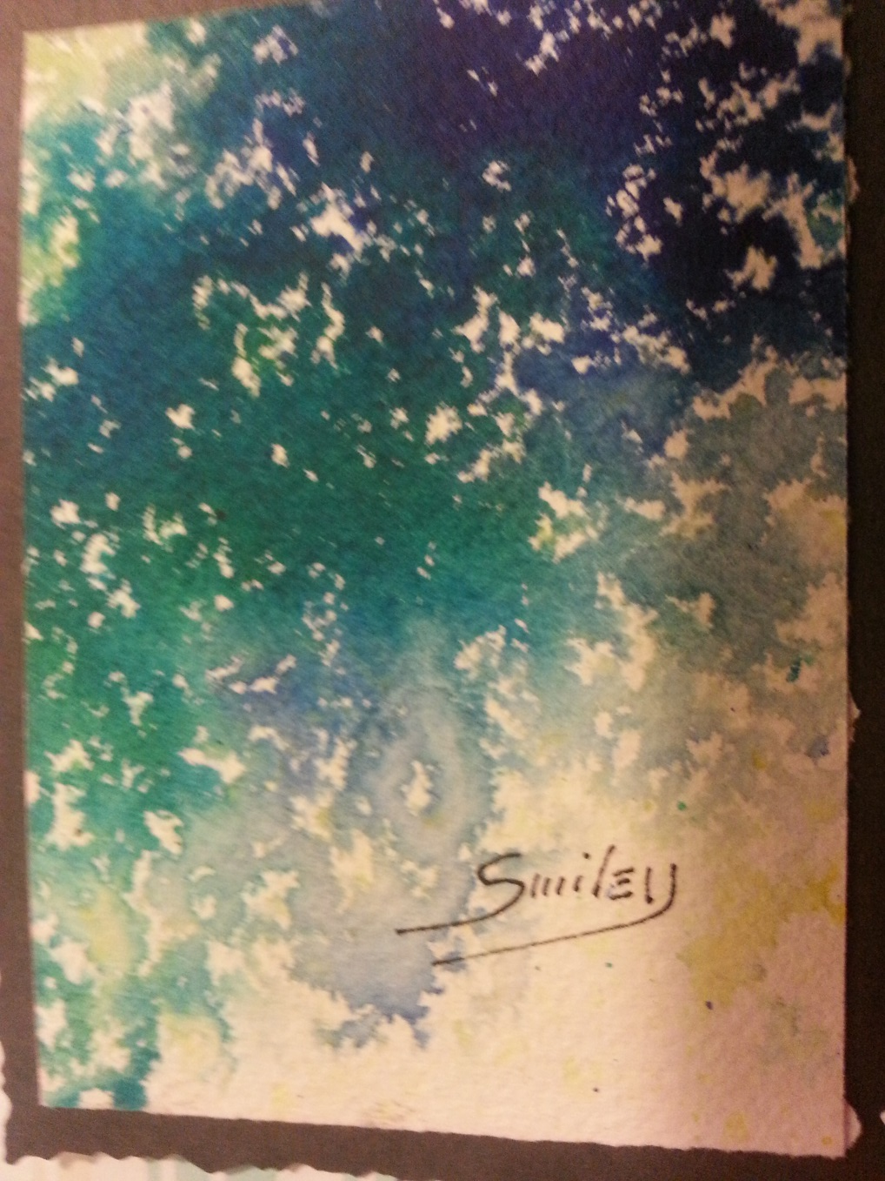
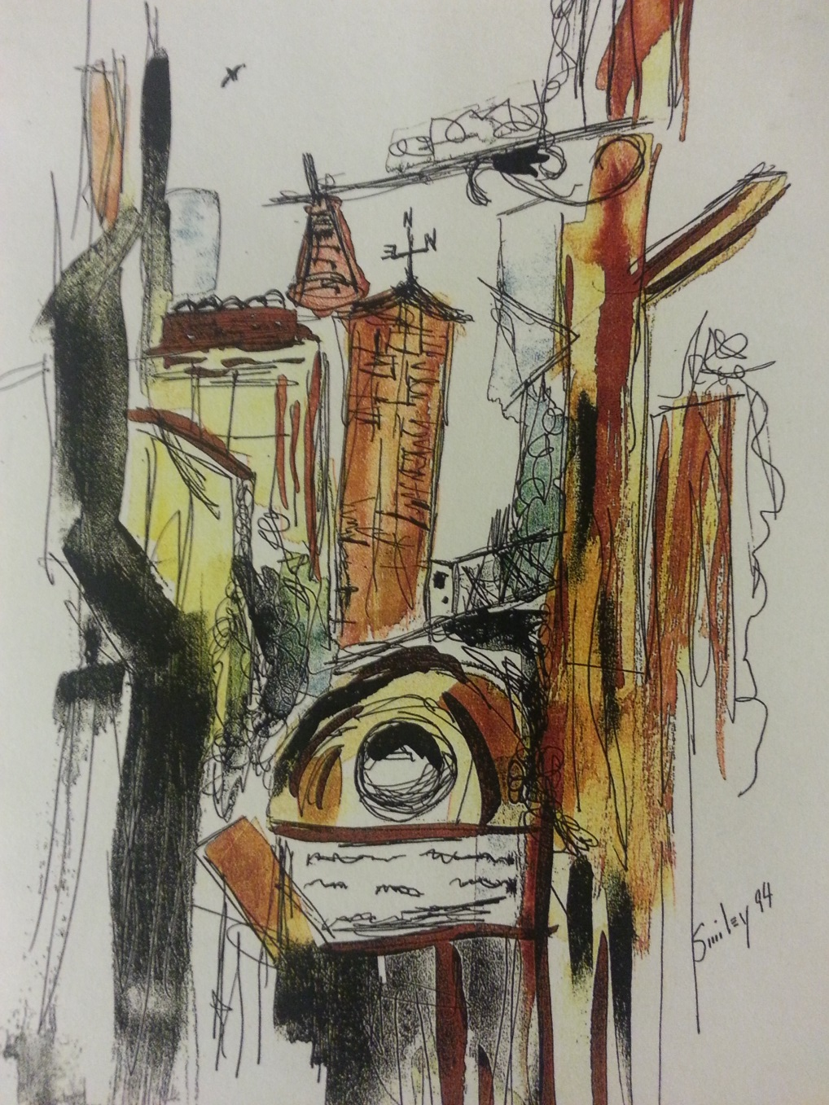

Slide 5
Unit Agenda
Monday, May 9th | Watercolor card project intro; begin work
Tuesday, May 10th through Wednesday, May 18th (with the exception of Friday, May 13th) | Work days on watercolor cards
Thursday, May 19th | Watercolor cards due
Friday, May 20th | Last Genius Hour for the semester; seniors may present their Genius Hour project today
Monday, May 23rd | Senior Finals—present Genius Hour; clean-out day: all students must clean out cubbies and classroom
Tuesday, May 24th and Wednesday, May 25th | Finals: Genius Hour presentations Finals Schedule: Tuesday, May 24th: periods 2, 4, 6 Wednesday, May 25th: periods 1, 3, 5

