Slide 1
Unit 3: Linocut Printmaking
Art with Ms. Gay
Spring 2017

Slide 2
What is a Linocut Print?
A linocut print is a form of printmaking. “Linocut” refers to the material used to make the print, which is linoleum (a soft type of rubber).
To make the print, you will cut into the linoleum using special tools.
What is carved into the linoleum will be inked and then printed onto a piece of paper.

Slide 3
Important things to know
For this unit, you will need to be mindful of positive and negative space.
What is left on the linoleum will be printed; what is carved away will not be printed.
The tools are sharp. We will have a lecture and then a QUIZ to review safety guidelines before using the tools.
You only get ONE piece of linoleum! If you are worried you will mess up or want a larger area to work with, Michael’s and craft stores sell linocut blocks.

Slide 4
Your Unit Project
You will make your own linocut print. You will create a design that uses three different textures or patterns.
In your sketchbook, you will need to create two different designs as rough sketches. I will give you final paper for you to draw your final design. Rough sketches should be completed no later than Thursday, February 16th.
The final design will be transferred from the drawing onto the linoleum. You will carve out the “negative” space and leave the “positive” space to be printed.
The final project will be your prints! You must try three and submit your best one for the project grade.

Slide 5
Unit Schedule
Monday, 2/13 | Linocut Printmaking intro; work on rough sketches in sketchbook (need two in order to move on to the final drawing).
Tuesday, 2/14 | Linocut Safety Lecture; work on rough sketches (can do the quiz this day if you feel ready)
Wednesday, 2/15 | Linocut Safety Quiz at the beginning of the period; rough sketches must be complete and must begin work on the final drawing
Thursday, 2/16 | Project rough sketches due by the end of the period—must have 2, we will pick the final one together
Friday, 2/17 | Genius Hour: mid-project evaluation (graded). Must have at least 5 components completed & documented on your sheet!

Slide 6
Unit Schedule
Week of Monday-Wednesday, 2/20-2/22 | Transfer final drawings to linoleum, carve designs. *SB #3 (free draw) due on Wednesday, 2/22 at the beginning of the period.
Thursday, 2/23 & Friday 2/24 | NO SCHOOL: RODEO BREAK!
Monday, 2/27-Wednesday, 3/1 | Make final linocut prints! Submit best print for grade. *If you finish your prints early, use this extra time to work on your Genius Hour project.
Thursday, 3/2 | Final linocut prints due by the end of the period—just need to see one final print (but can be submitted earlier than today).

Slide 7
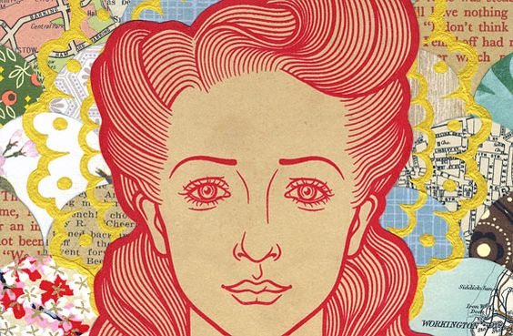
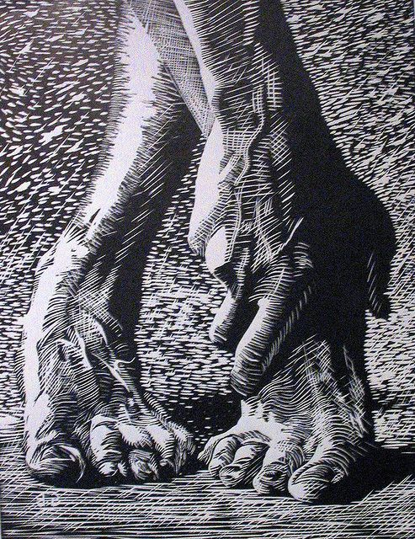
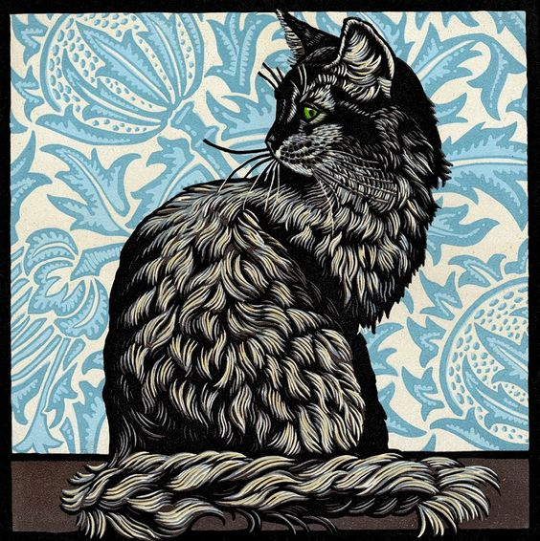
Examples of awesome linocut prints

Slide 8
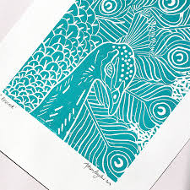
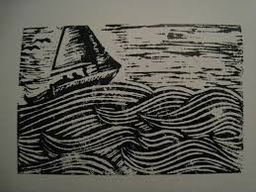
More awesome but simple linocut prints

Slide 9
Things to consider to make an awesome print
TEXTURE: fur/hair, animals
Using cross-hatching effects
Creating a scene—can easily incorporate several different textures in this way
Nature/things from nature, such as plants, flowers, fruit, etc.
Keep in mind your knowledge of composition and Rule of Thirds!!

Slide 10
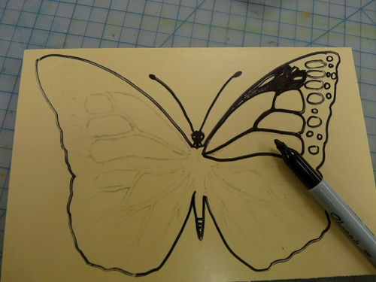
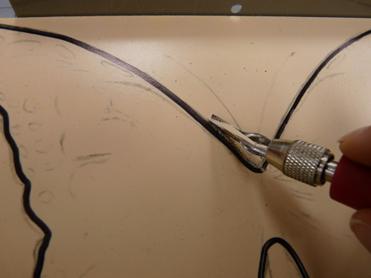
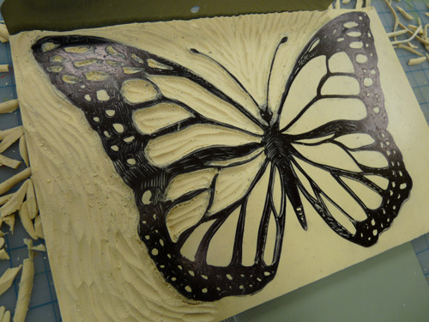
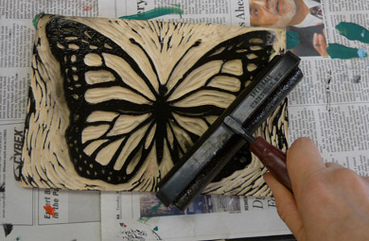
Linocut Printmaking Process in Pictures
Step 1
Step 2
Step 3
Step 4

Slide 11
Linocut Printmaking Process Video
https://www.youtube.com/watch?v=WmLd4O2ROJo

