Slide 1
Unit 2: Tattoo History, Flash & Project
Art with Ms. Gay
Spring 2017

Slide 2
Tattoo History
The word “tattoo” is derived from the Tahitian word “tatu,” which means “to mark”
Tattoos and tattooing tools have been discovered from time periods as early as ~3000 B.C.
In ancient cultures, tattoos had many different functions: to indicate status (Egypt & Japan); cultural symbols (India); to indicate criminal status (China); for ritual (Samoa); for religion and medicine (Egypt).
Tattoos are a remnant of the Samurai in Japan—when forced to disband, the Samurai used tattoos to show organization (Yakuza soon followed)
The practice of sailors getting tattoos date back from 1700s England, from expeditions to Tahiti

Slide 3
Contemporary Tattooing
Modern electric tattoo machine invented in late 1880s
After the 1970s, tattoos became an accepted form of self expression
Influx of artists to market led to more developed tattoo practices and tools; now most artists have fine arts training/backgrounds
Tattoos have varied cultural significance: showed defiance in the early 1900s; played a large part in the feminist movement; the popularity of “sleeves” or “full body art” is a resurgence from Japanese tattoo art.

Slide 4
Notable Tattoo Artists
Kat Von D
Started tattooing at 16, specialty is in portraiture/realism; considered a celebrity due to shows Miami Ink and LA Ink
Corey Miller
Known for traditional styles that include dragons and portraits; especially famous for freehand work (no stencil used at all!); worked with Kat Von D on LA Ink
Hannah & Guy Aitchison
Hannah works mostly with pinups/color; was also on LA Ink
Guy is also a painter and mainly works in “psychedelic”/biomechanical art forms
Don Ed Hardy
Apprenticed under Sailor Jerry Collins; owns the clothing brand Ed Hardy; known for American/Japanese fusion-style tattoos that were influenced from learning tattooing in Japan; his son, Doug Hardy, is also a famous tattoo artist
Haylie Gay
Known for full color and realistic tattoos—my little sister! GO SEE HER!

Slide 5
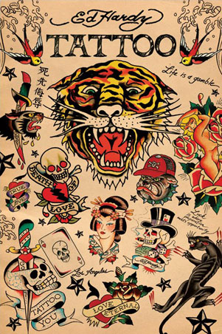
Tattoo Portfolios: Don Ed Hardy

Slide 6
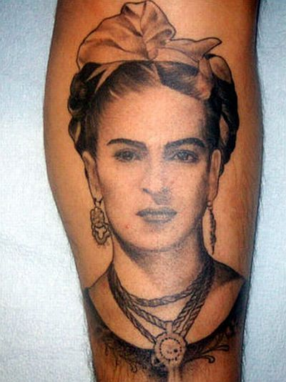
Tattoo Portfolios: Kat Von D

Slide 7
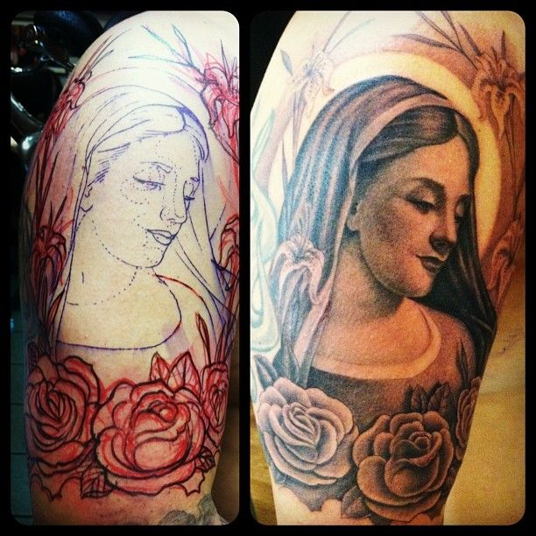
Tattoo Portfolios: Corey Miller

Slide 8
Tattoo Portfolios: Hannah Aitchison

Slide 9
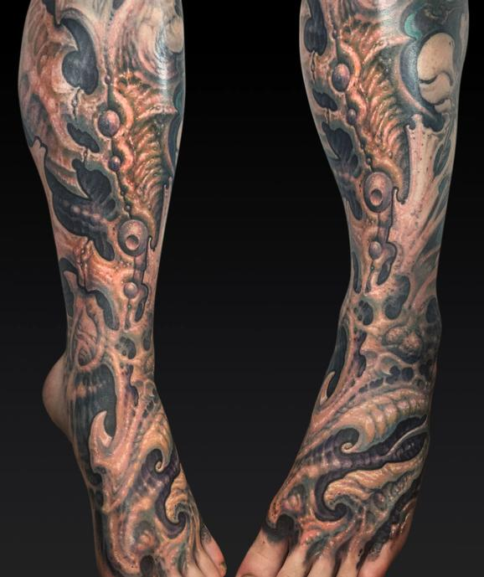
Tattoo Portfolios: Guy Aitchison

Slide 10
Tattoo Portfolios: Haylie Gay

Slide 11
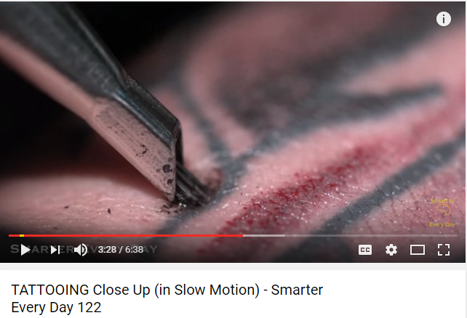
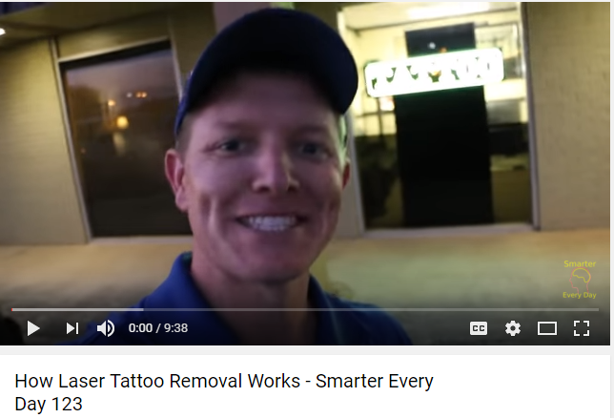
Tattoo Videos

Slide 12
Unit 2: Tattoo Art Project
There are two parts to this project, each worth 10 points:
Design a sheet of tattoo flash that embodies your own “tattoo art style.” Must include at least 5 different designs (should be a variety) of drawn and colored images.
Do rough sketches (at least one of each design) in your sketchbook of your flash designs. Final paper will be provided (standard 8.5 x 11” size).
2. You will be given a “client” to design a tattoo for. This will be on a sheet and will include details such as what the client wants, color/black and white, area of the body, size, etc.
Do at least one rough sketch of your final design in your sketchbook. Final paper will be provided.
Interim due dates for rough drafts: 1st rough draft for one part of the project due on Thursday, January 26th; 2nd rough draft for other half of the project due on Thursday, February 2nd
TENTATIVE DUE DATE: Thursday, February 9th at the beginning of the period

Slide 13
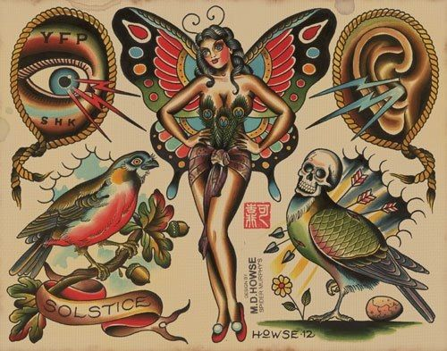
Tattoo Flash Examples

Slide 14
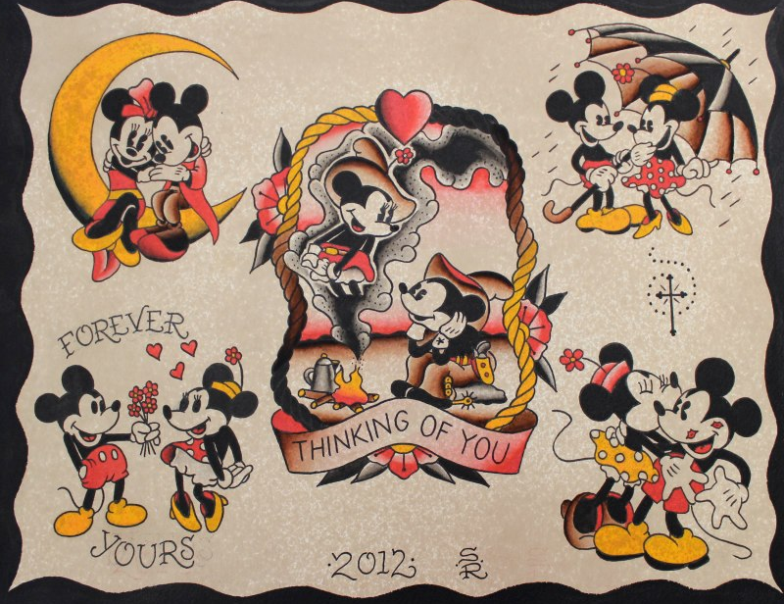
Tattoo Flash Examples

Slide 15
Sketchbook Assignment #2
This assignment has been changed from what is on your half-sheet given to you at the beginning of the semester. Please make a note of these changes in your notes.
For Sketchbook Assignment #2, you will need to research a tattoo artist (can be from anywhere in the world, including from here in Tucson).
Design your own tattoo image based on your selected tattoo artist’s style.
On the back of your drawing, write the tattoo artist’s name and style.
Same due date as before: Thursday, February 2nd at the beginning of the period

