Slide 1
Street Art
Beginning Art with Ms. Gay
Fall 2016

Slide 2
What is this?

Slide 3
Who is this?

Slide 4
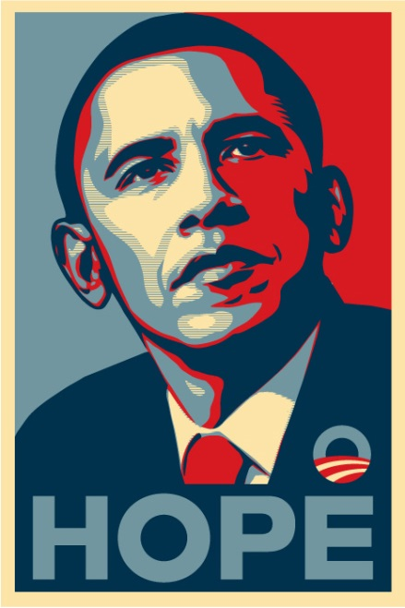
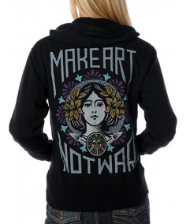
Shepard Fairey
Street artist who works primarily with stencils, but also has a unique graphic design style
Owns and created the Obey clothing line
Created the Obama “Hope” poster for the 2008 campaign
Academically trained at the Rhode Island School of Design

Slide 6
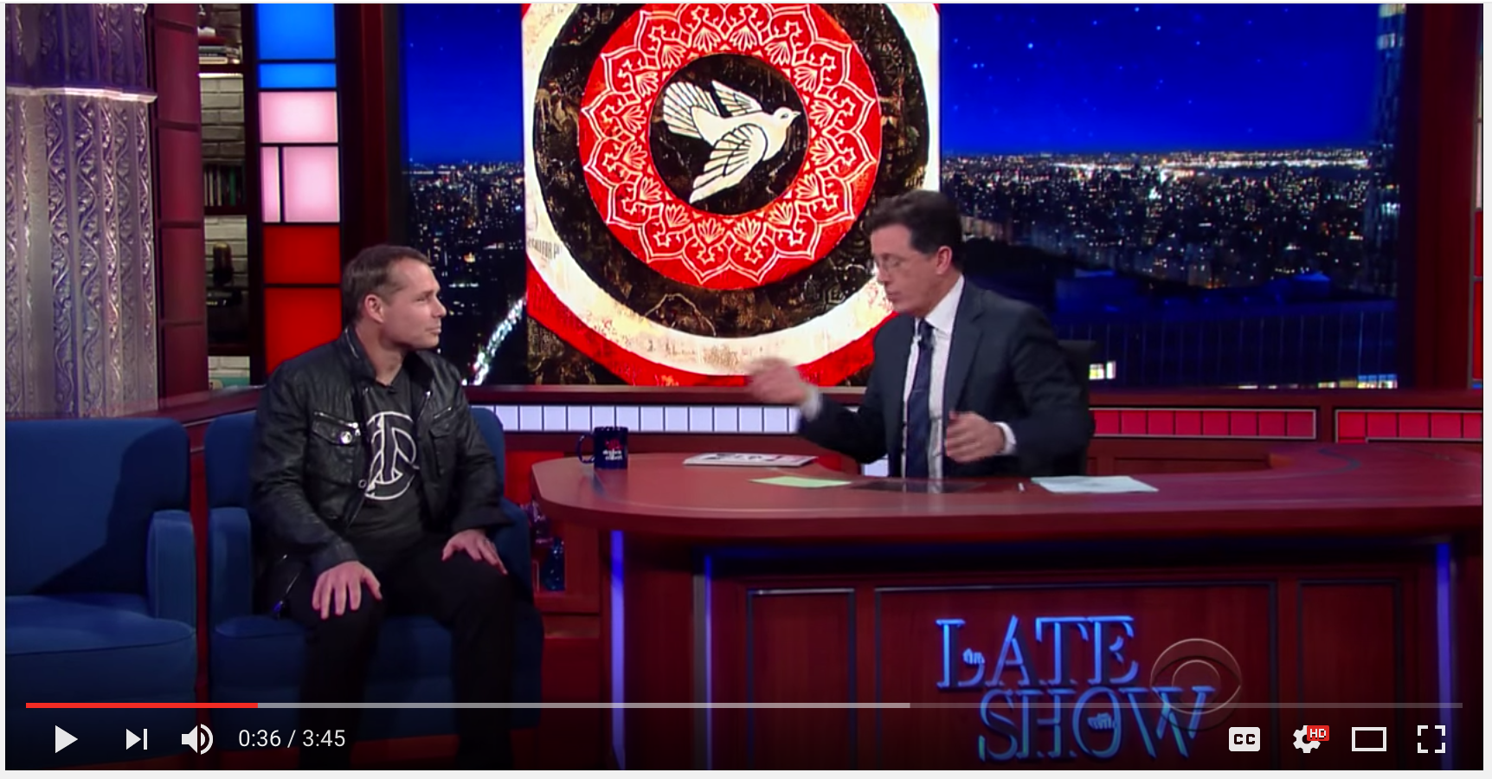

Slide 7
Who is This?

Slide 8
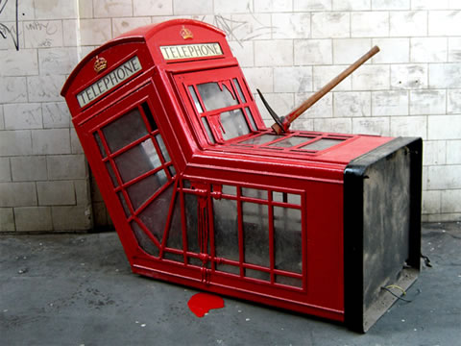
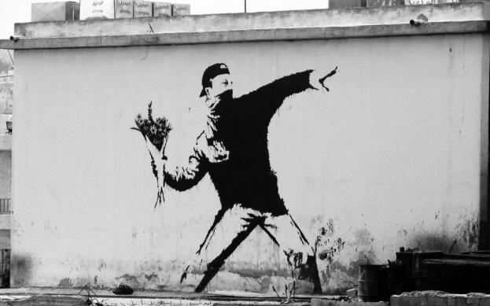
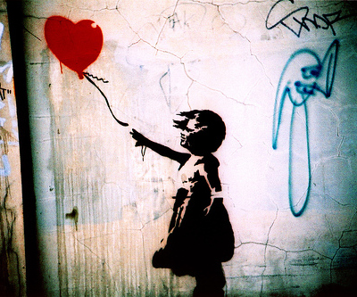
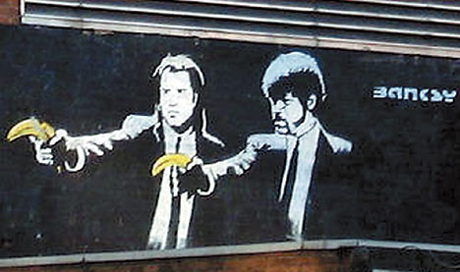
Banksy
Anonymous street artist, famous for stencils
From England, but has done works all over the world
Created “Exit Through the Gift Shop”
Did an artist residency in New York

Slide 10
Unit 8 Project
Create your own street art image
Can be in any street art style and use text and/or imagery
Consider: this is an image you want to perpetuate. What is something that you can give meaning to (can be personal, societal, etc.) that you would want others to see?
Due on Thursday, November 17th at the end of the period
Sketchbook Assignment #6: research a street artist and create an image using their style.
This is due on Thursday, November 17th at the beginning of the period.
Some suggestions for street artists:
Banksy
Keith Haring
Invader
SAMO
Jean Michel Basquiat
Swoon
Andre/Mr. A
Above
Mr. Brainwash
L7M

