Slide 1
Genius Hour: Semester Project & Art Final
Beginning Art with Ms. Gay
Fall 2016

Slide 2
What is Genius Hour?
Genius Hour is an hour during art class each Friday where you can work on your own self-guided art project.
This concept is based on Google’s Genius Hour, where Google engineers spend one hour each week working on their own projects. This is where Gmail and Google News have come from.

Slide 3
Genius Hour F.A.Q.
Can I make anything I want?
Yes, with limits. Your project should be something that can be reasonably created over the semester. Some materials are off-limits.
Can I spray paint?
Not on campus. You may use spray paint on your own at home, but not for the entire project. For example, maybe you create an acrylic painting, but you want part of it to be spray-painted. So you would take it home to do the spray paint portion, then bring it back to school to continue working on it.
Can I work on my Genius Hour project at home?
Yes! However, the whole project cannot be done at home. You are expected to work every Friday and to have your project with you, then take it home to work after class.
Can I work with a friend on a project?
Yes. Both of you will need to submit the assignments individually and each part you will be working on will need to be well defined. No one should be sitting around doing nothing on Fridays.

Slide 4
Originality
All projects should be original ideas and work.
Be careful when searching the internet for examples of work. If I were to find out that you copied artwork off of the internet, this could be considered plagiarism and have serious consequences.
It is okay for someone else’s work to inspire you, but it is not okay to replicate someone else’s work entirely.
You can take parts of other work and change them to be your own. This is called appropriation, which is something many artists do.

Slide 5
Proposal of 3 Ideas
Your first assignment for Genius Hour is a Proposal of 3 Ideas.
You will need to come up with three unique ideas for your Genius Hour project.
For each idea, you will need to include the following:
A written description of what you want to make and why (1-2 sentences is fine)
Rough sketches in the form of thumbnails (1-2 images for each is fine)
Materials you will need to make the project
Complete this assignment in your sketchbook, and then tear out and submit on Friday, August 19th.

Slide 6
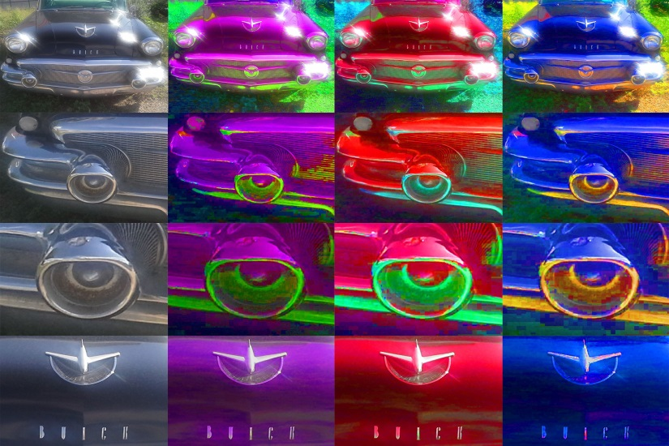
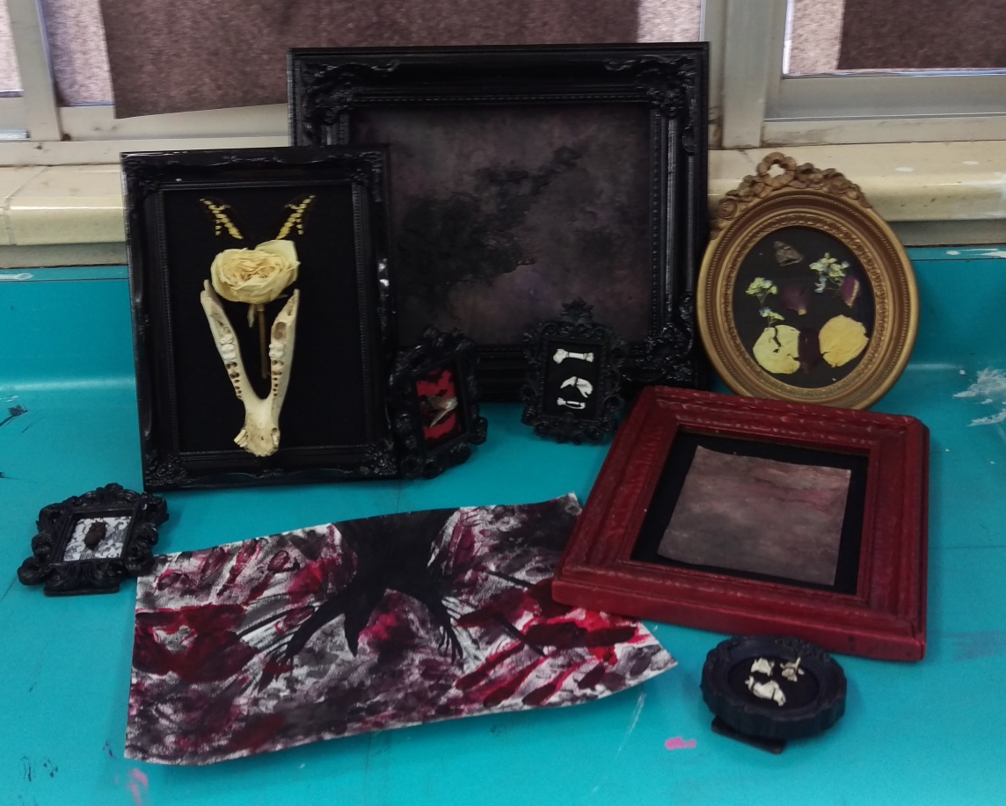
Examples of Awesome Genius Hour Projects

Slide 7
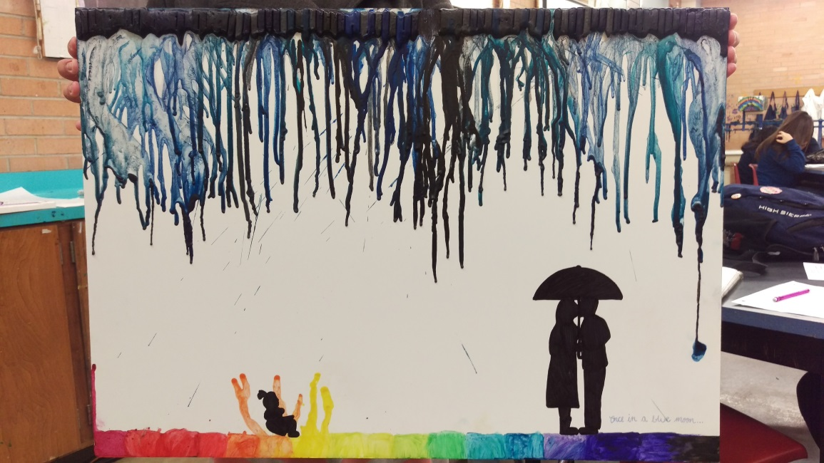
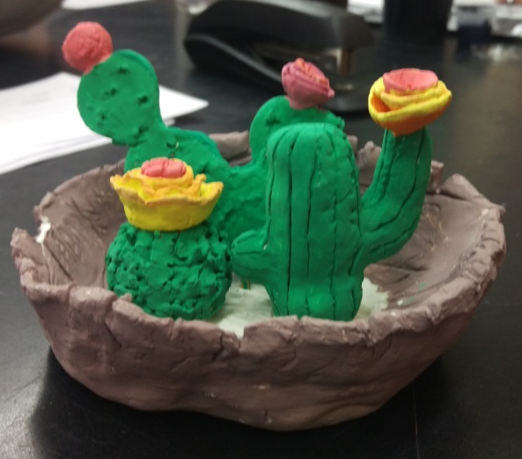
Examples of Awesome Genius Hour Projects

Slide 8
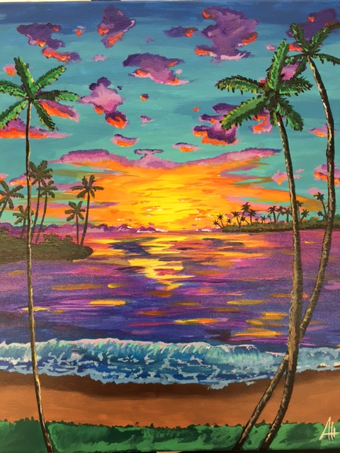
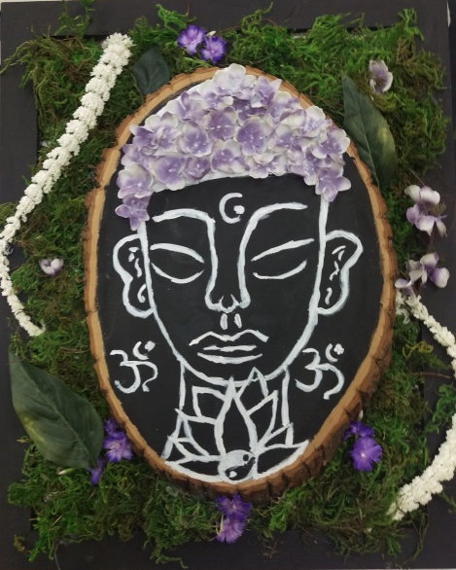
Examples of Awesome Genius Hour Projects

