Slide 1
Composition
Art with Ms. Gay
Fall 2016

Slide 2
What is Composition?
Composition definition: how elements are arranged in the picture plane. Basically, how “things are set up” for the viewer of the image.
Rules of Composition:
Rule of Thirds
The most fundamental rule of composition! The picture plane is divided into thirds both horizontally and vertically, and each intersection creates a “focal point.”
Fibonacci Sequence
It gets crazy here with math…but also really awesome. The picture plane is divided into mathematical parts (a number sequence) that form a spiral shape.
The Golden Ratio/Mean
Part of Fibonacci sequence, equivalent to a proportion of about 1.618. This is considered the “perfect” proportion.
The Golden Spiral
X’s and “leading lines/arrows”
The intersection of lines that create “x’s” are compositionally strong elements, as well as “lines” that lead the viewer’s eye through the image.

Slide 3
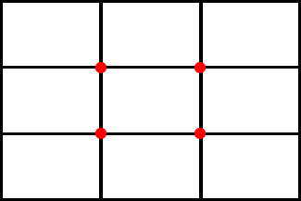
Rule of Thirds
The focal points of the image should be where the red dots are.

Slide 4
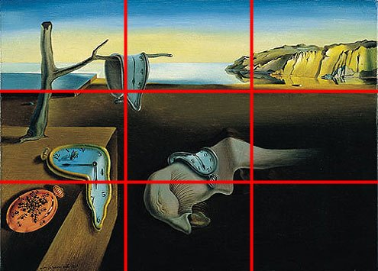
Rule of Thirds
The first person to guess this artist is my favorite and also earns extra credit.
Notice how all of the “elements” of the painting are placed around where those “red dots” would be…where each of the boxes intersect.

Slide 5
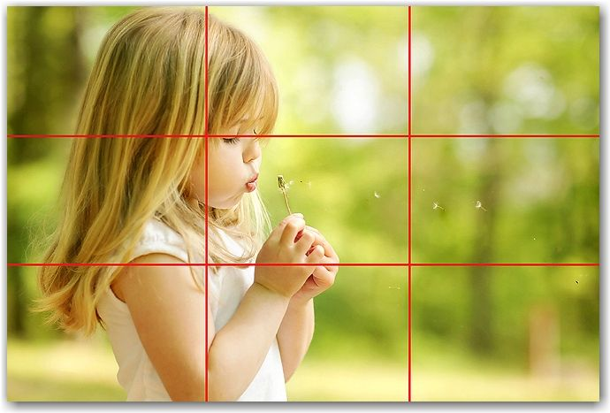
Rule of Thirds

Slide 6
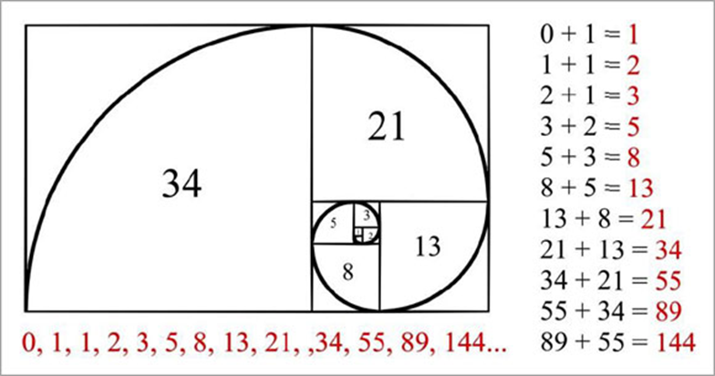
Fibonacci Sequence
Definition: F_{n} = F_{n-1} + F_{n-2}
Just kidding…well not really, that is what it means. In art, that formula creates a series of numbers that have real-world application (plants, animals, patterns, etc.).
This number series creates the Golden Spiral and the Golden Mean, both of which are seen and applied in compositionally strong art.

Slide 7
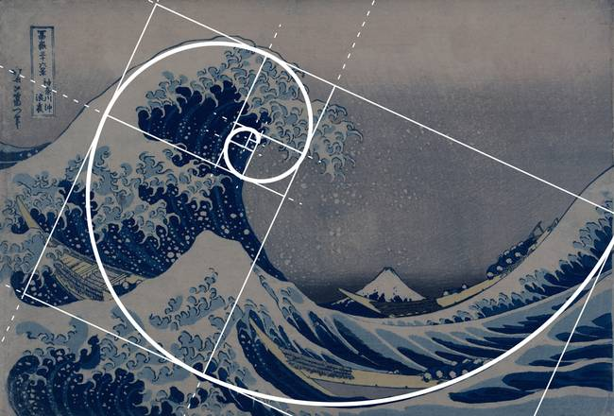
Fibonacci Sequence

Slide 8
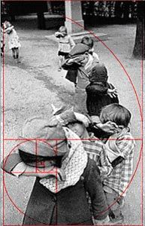
Fibonacci Sequence

Slide 9
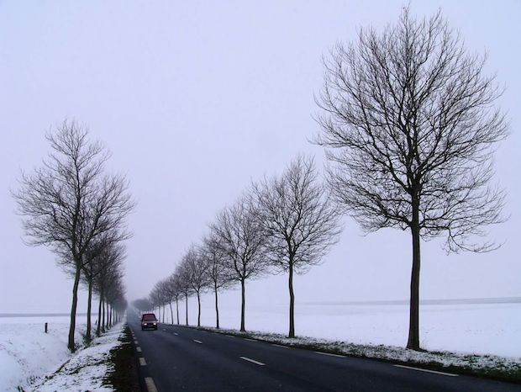
X’s and Leading Lines/Arrows
Based on our Rule of Thirds and Fibonacci Sequence, we can also take our compositions a step further and look for X’s or leading lines/arrows in the image.

Slide 10
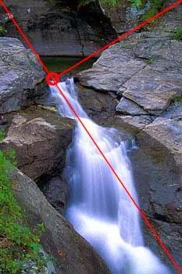
X’s and Leading Lines/Arrows

Slide 11
Other Tips & Tricks
Not just the Rule of Thirds, but also the Rule of Threes: choose objects/elements in groups of 3
Cropping: take out the excess “space” or “information” that isn’t necessary to the viewer
Create patterns and rhythm in the image (we’ll continue to learn about this)
Rules are made to be broken (in art). Experiment, change your composition until it feels “right” (i.e., ask someone else who will give you an honest opinion!)

Slide 12
Quick Composition Quiz
Look at each image and point out which rules of composition it exhibits. Does the image have a good composition? Why or why not?

Slide 13
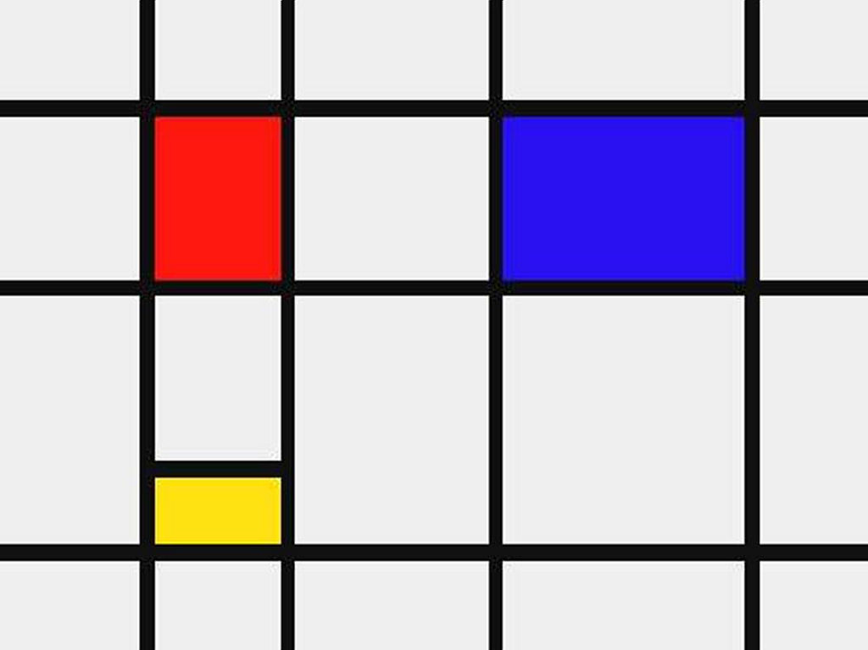
Quick Composition Quiz

Slide 14
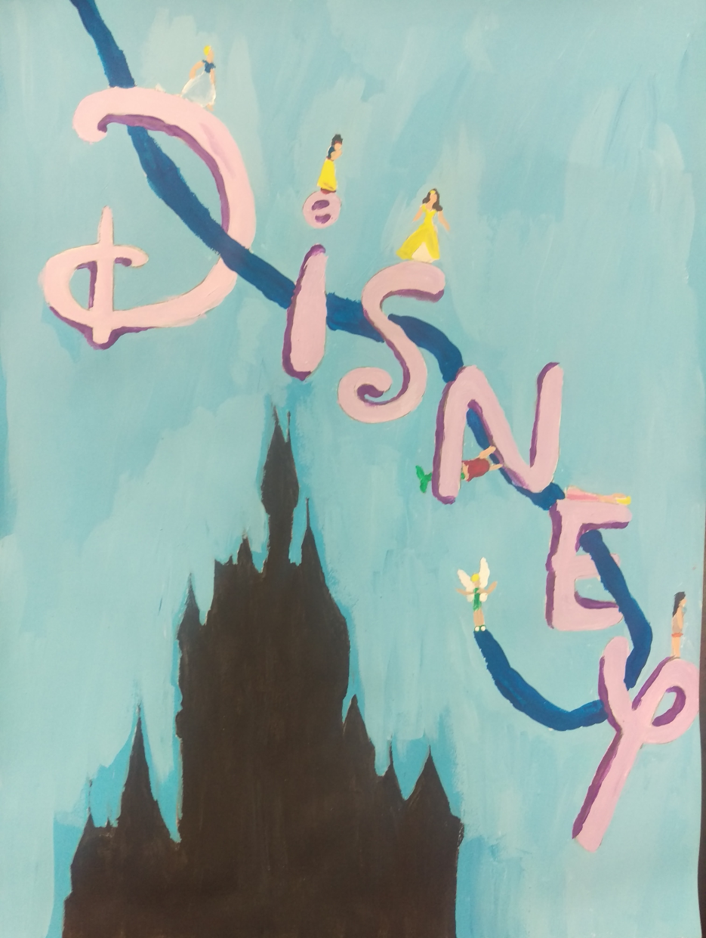
Quick Composition Quiz

Slide 15
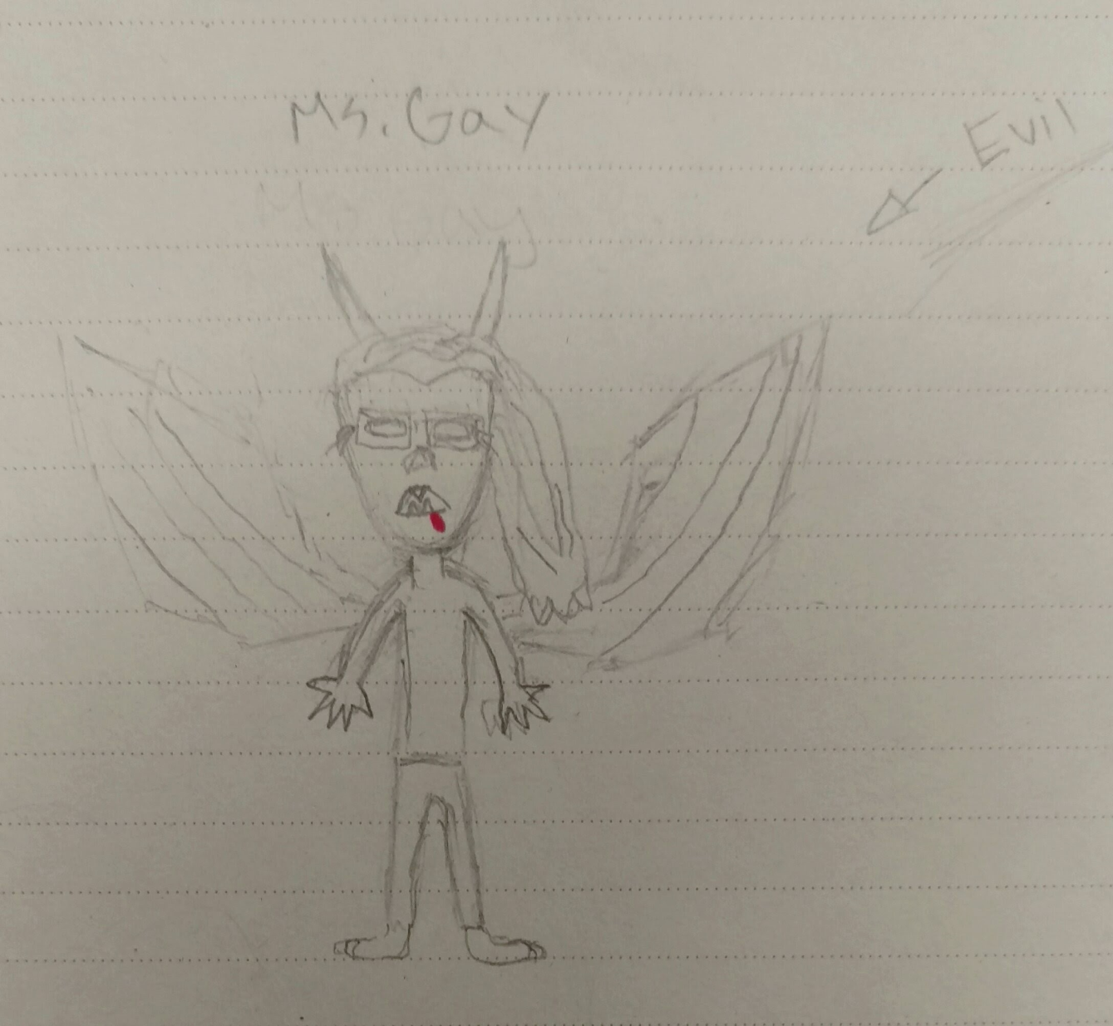
Quick Composition Quiz

Slide 16
Class Activity
Each group of about 4 students should have their own paper and pencil.
On your paper, arrange the following three emojis to create a composition based on the rules we just reviewed.

