Slide 1
I missed you guys!
Art with Ms. Gay
January 11th, 2016

Slide 2
What’s New this Semester, Part 1
New TARDY policy
For every tardy, you will owe time during conference period in my classroom. You will be required to make up work. I will automatically assign this time and let your parents know.
Genius Hour
Major changes—stay tuned. We will discuss this on Friday this week.
Gallery Walk written assignments
More information to come soon, check the class website.
Absent binder
Semester schedule
NO POINT BANK.
You own all of your grades. Had there not been a point bank in place last semester, nearly half of students would have failed the course. This is UNACCEPTABLE.

Slide 3
What’s New this Semester Part 2
Intermediate Art: artistic concentration
Intermediate art students ONLY will select a concentration (drawing, painting, etc.; focus on human figure, portraits, flowers, etc…) and submit 5 works as part of a portfolio. More info to come.
Artsonia online: we will set this up together and upload images when our first project is due.

Slide 4
What’s NOT New this Semester
Sign out on the white board when leaving
Located next to my desk. I need to know where you are when you leave the classroom.
Also, ERASE YOUR NAME WHEN YOU RETURN TO CLASS. Seriously, guys…kindergartners can do this.
Passes: new, but they do the same thing
Welcome the Kardashian family!
Classroom expectations
Cleaning up
Behavior & consequences

Slide 5
The Class Website
What is the website address?
How do we access it?
What are each of the pages for?
Here we go—we’re going to do it all together now!

Slide 6
Bee Tee Dubs…You have a quiz this week.
Heads up: pop quiz sometime this week on classroom expectations, it WILL be graded and if you fail, I will contact home and let parents know you will be coming in to make up the grade.
SKETCHBOOK GRADE: this Friday, your first sketchbook assignment will be to…have your sketchbook with you, ready for class. Yeah, that’s it. So if you ran out of pages last semester, it’s time to get a new one. THIS CANNOT BE MADE UP.

Slide 7
A Look Back at Fall 2015
Let’s take a look back at what we learned in the Fall of last year (not really in order or all inclusive):
Line: contour line; hatching; cross-hatching; sketching; general shapes method (our favorite!); cartooning; perspective drawing
Shape/Form: shading; rendering 3D objects; using charcoal; gestures
Color: color theory; mixing colors; values
Texture: advanced drawing techniques to show texture; value scales
Torn mosaic
Watercolor painting techniques
Meaning and symbolism in art, through learning about Dias de los Muertos
Exquisite Corpse
All of the amazing things you all learned individually through your Genius Hour projects. I’m so proud!

Slide 8
Our First Unit of the New Semester…aww!
Given all that we learned last semester, we are going to get REALLY nerdy with the art this semester.
To start off, we are going to study composition.
What is composition? Discuss with your neighbor/group for a couple of minutes.

Slide 9
Unit 1, Semester 2: Composition
(Hint: it might help you to take notes now. I was nice last semester and let you have Genius Hour as your final, but no guarantees that will happen again this semester.)
Composition definition: how elements are arranged in the picture plane. Basically, how “things are set up” for the viewer of the image.
Let’s look at some examples…

Slide 10
Rules of Composition
Rule of Thirds
The most fundamental rule of composition!
Fibonacci Sequence
It gets crazy here with math…but also really awesome.
The Golden Ratio
The Golden Spiral
X’s and “leading lines/arrows”

Slide 11
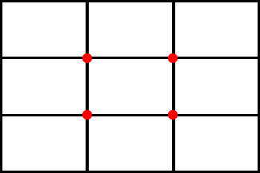
Rule of Thirds
The focal points of the image should be where the red dots are.

Slide 12
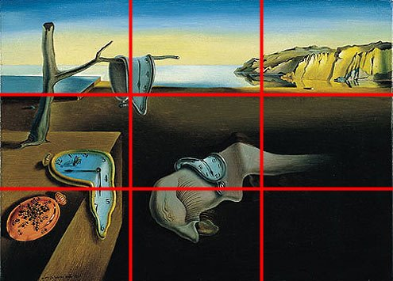
Rule of Thirds
The first person to guess this artist is my favorite and also earns extra credit.
Notice how all of the “elements” of the painting are placed around where those “red dots” would be…where each of the boxes intersect.

Slide 13
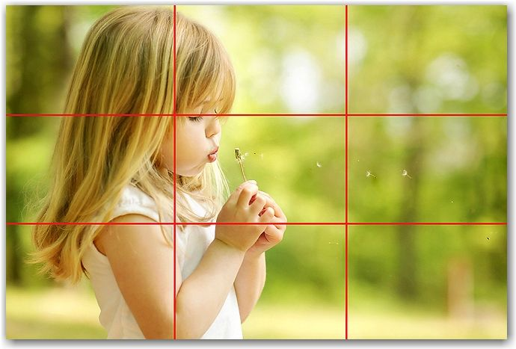
Rule of Thirds

Slide 14
Fibonacci Sequence
Definition: F_{n} = F_{n-1} + F_{n-2}
Just kidding…well not really, that is what it means. In art, that formula creates a series of numbers that have real-world application (plants, animals, patterns, etc.).
This number series creates the Golden Spiral and the Golden Mean, both of which are seen and applied in compositionally strong art.

Slide 15
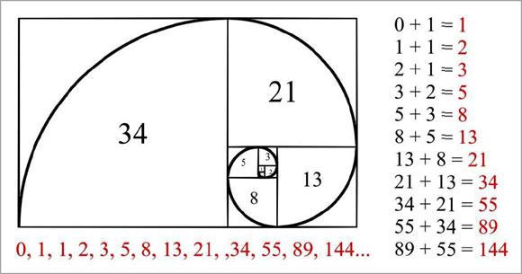
Fibonacci Sequence
The Golden Spiral:
The Golden Mean: the perfect proportion (= ~1.618) that is derived from the Fibonacci series. Many things from nature tend to have this “perfect proportion” that can be mathematically verified (think faces, sea shells, plants, etc).

Slide 16
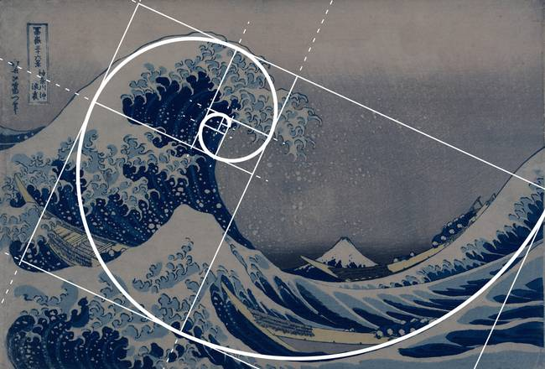
Fibonacci Sequence

Slide 17
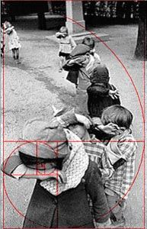
Fibonacci Sequence

Slide 18
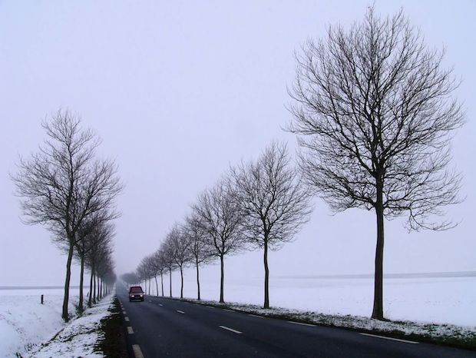
X’s and Leading Lines/Arrows
Based on our Rule of Thirds and Fibonacci Sequence, we can also take our compositions a step further and look for X’s or leading lines/arrows in the image.

Slide 19
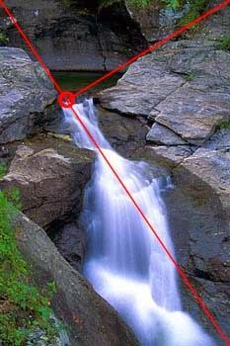
X’s and Leading Lines/Arrows

Slide 20
Other Tips & Tricks
Not just the Rule of Thirds, but also the Rule of Threes: choose objects/elements in groups of 3
Cropping: take out the excess “space” or “information” that isn’t necessary to the viewer
Create patterns and rhythm in the image (we’ll continue to learn about this)
Rules are made to be broken (in art). Experiment, change your composition until it feels “right” (i.e., ask someone else who will give you an honest opinion!)

Slide 21
Quick Composition Quiz
Look at each image and point out which rules of composition it exhibits. Does the image have a good composition? Why or why not?

Slide 22
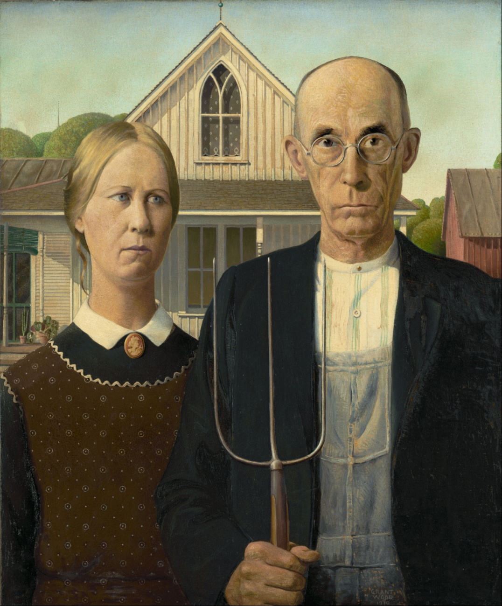
Quick Composition Quiz

Slide 23
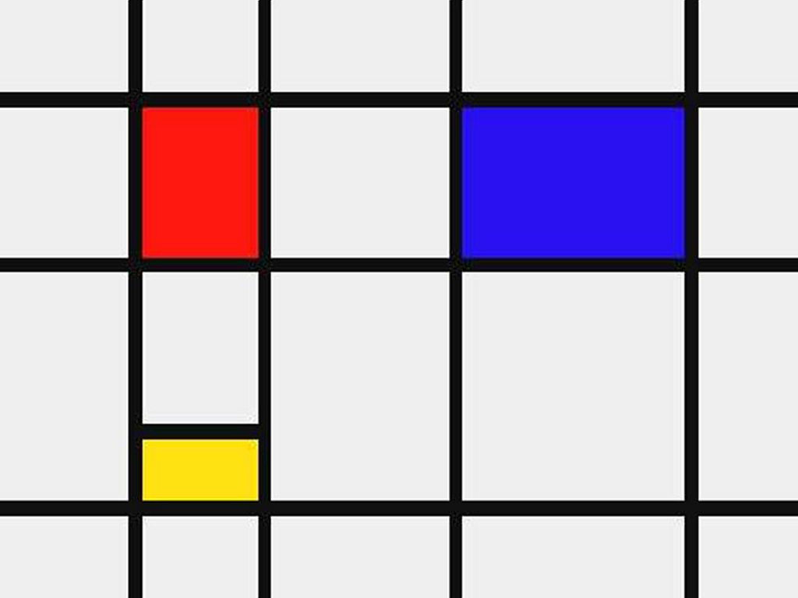
Quick Composition Quiz

Slide 24
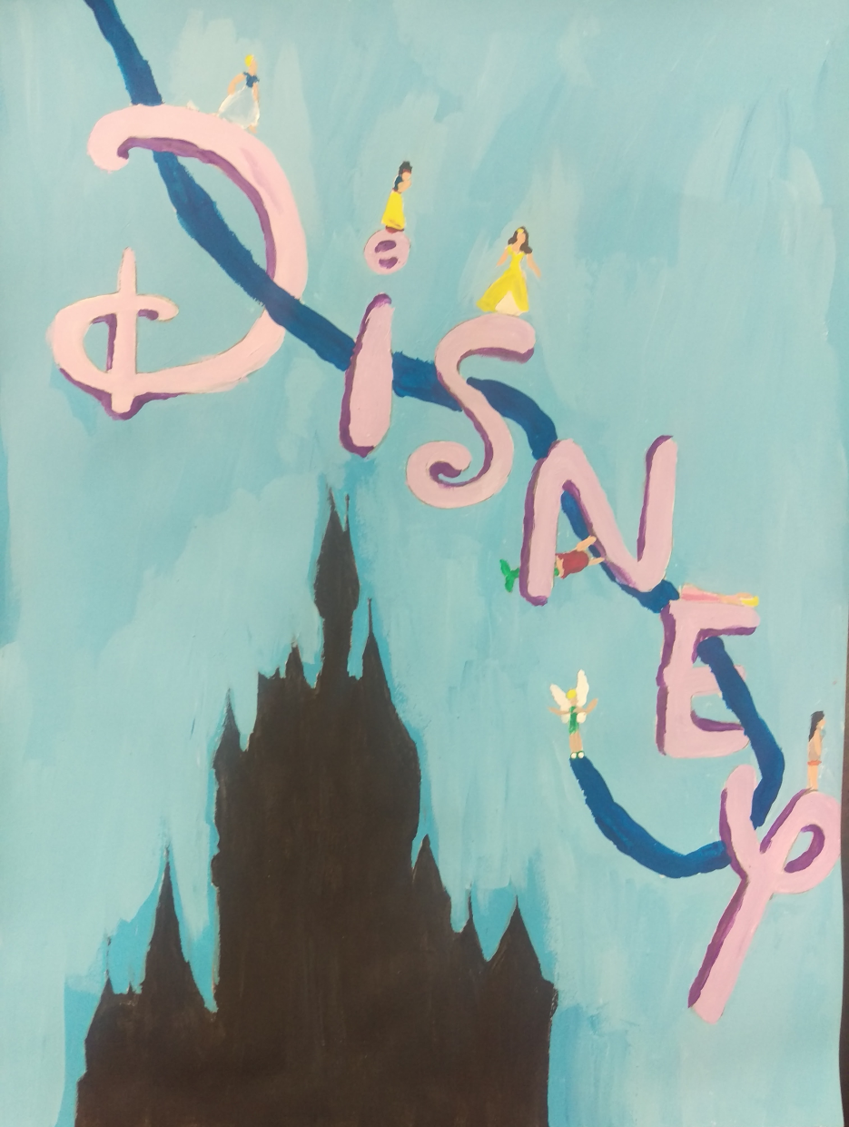
Quick Composition Quiz

Slide 25
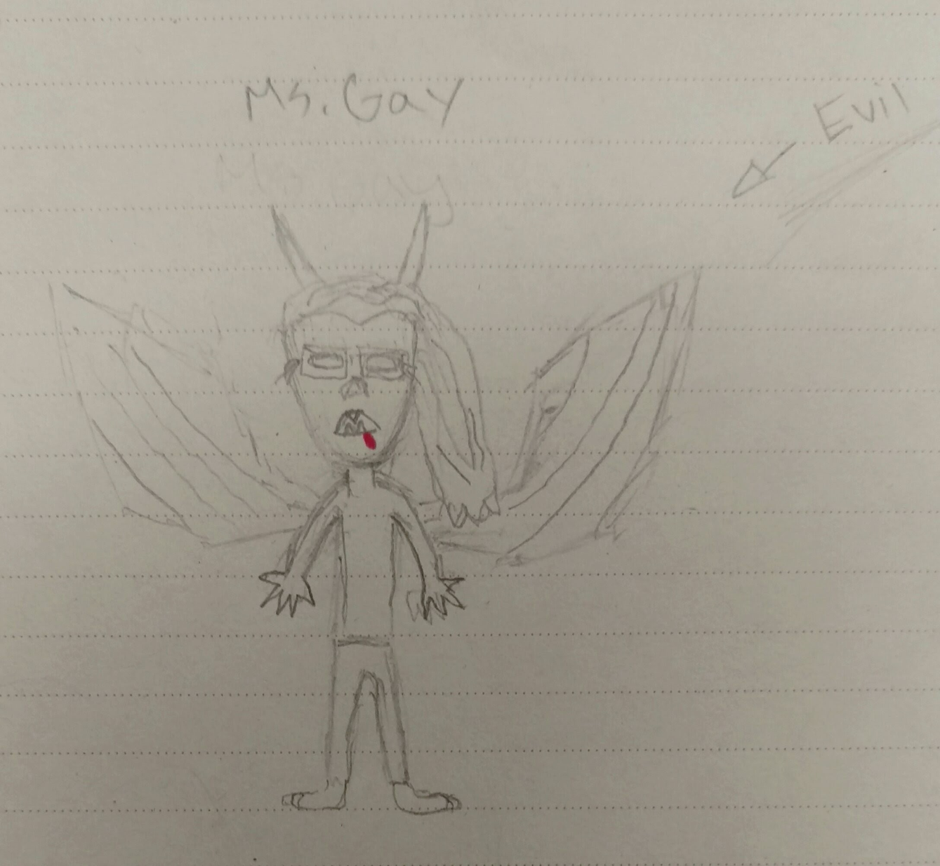
Quick Composition Quiz

Slide 26
Class Activity
Each group of about 4 students should have their own paper and pencil.
On your paper, arrange the following three emojis to create a composition based on the rules we just reviewed.

Slide 27
Unit Project and Sketchbook Assignment
For this unit you will need one object to draw from (must be a physical object you can bring with you or take pictures of; something small is best).
You must create one large drawing that incorporates at least six compositions of that object.
Your compositions should exhibit the rules we reviewed during class.
The final drawings can either be colored or done with just pencil, but if only using pencil you must use shading.
Sketchbook Assignment #1, Semester 2: watch one of your favorite movies. Pause it during a scene that exemplifies one of the rules of composition and sketch it. Make sure to fill the page!

Slide 28
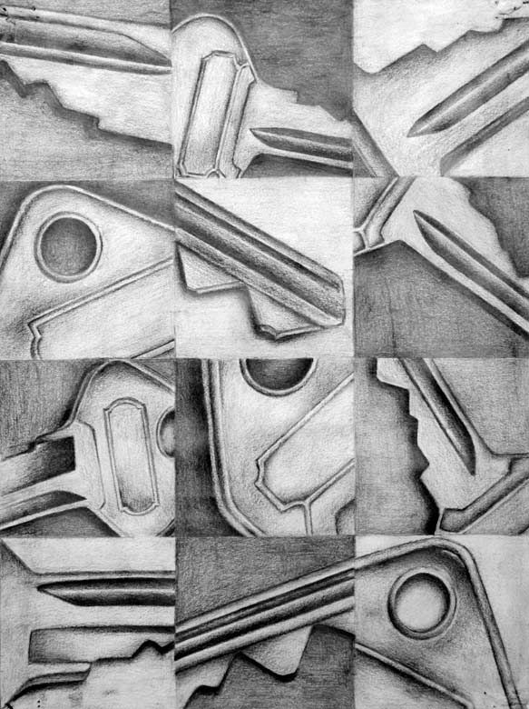
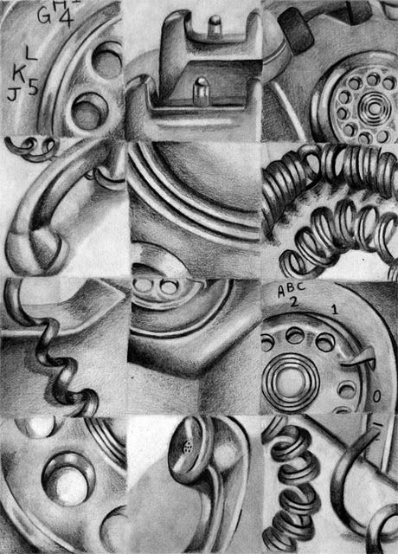
Unit Project Examples

Slide 29
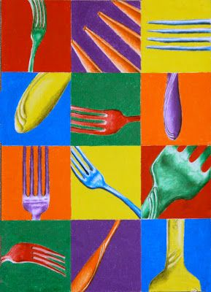
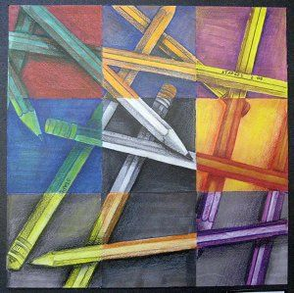
Unit Project Examples

